Slide 1

Image Super Resolution
Using Deep Learning

Slide 2
Team Members
Janna Allah Ayman El-Kayyali
Sief El-Deen Mostafa
Tarek Magdy Ahmed
Amr Shaaban Mahmoud
Mohamed Saad Labib
Adham Tarek Mohamed
Abdelrahman Mohamed Ahmed

Slide 3
Supervisors
Prof. Dr. Hafez Abd-elWahab
T.A. Dawood Essam

Slide 4
01
02
03
04
Introduction
Literature Review
System Description
System Implementation
Applications
Motivation
Objective
Problem Statement and Solution
Planning
Model Frameworks
Up-sampling Methods
Network Designs
Similar Applications
Platform
Training Dataset
Models

Slide 5
05
06
07
08
System Testing
GUI demo
Conclusion
Future Work
Methods of Assesments
Datasets
Results

Slide 6
01
Introduction

Slide 7
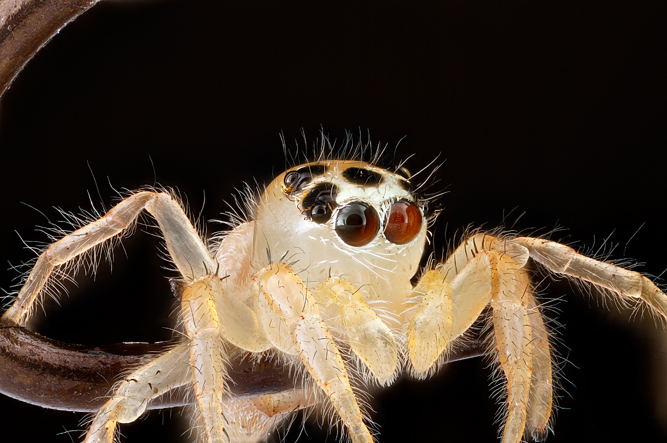

INTRODUCTION
Image super-resolution (SR), which refers to the process of recovering high resolution (HR) images from low resolution (LR) images, is an important class of image processing techniques in computer vision and image processing.
X2
Low Resolution
(256,256)
Super Resolution
(512,512)

Slide 8
INTRODUCTION
Applications
Motivation
Objective
Planning
Problem Statement and Solution

Slide 9
Applications

Slide 10
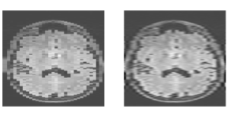
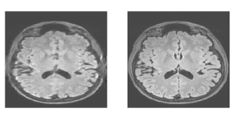
Medical diagnosis
Magnetic Resonance Imaging (MRI) is useful to provide detailed anatomical information, such as images of tissues and organs.
Processing the low resolution MRI may lead to an incorrect diagnosis.
Low Resolution
Super Resolution

Slide 11
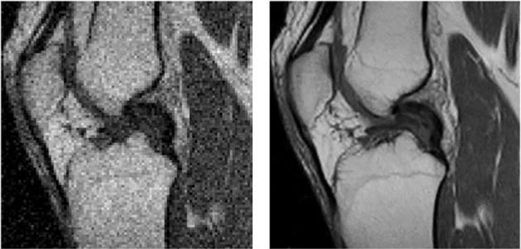
Medical diagnosis
SR result on the MRI knee image with a magnification factor of 4.
Low Resolution
Super Resolution

Slide 12
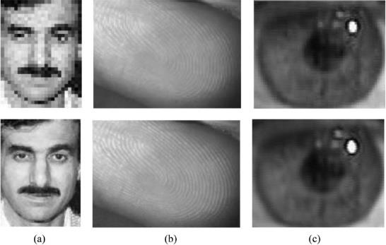
Biometric information identification
The resolution of biometric images is pivotal in the recognition and detection process.
Low Resolution
Super Resolution

Slide 13
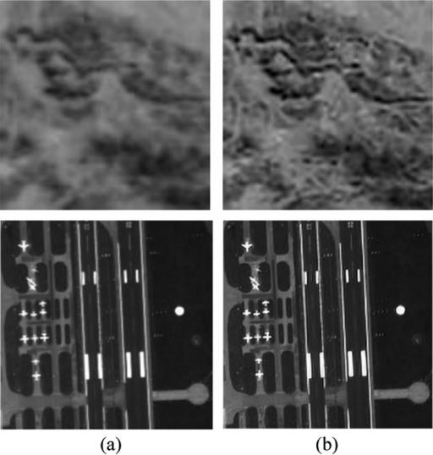
Earth-observation remote sensing
Remote sensing is the technique of observing and analyzing objects from a distance without being in direct contact with them.
Low Resolution
Super Resolution
Low Resolution
Super Resolution

Slide 14
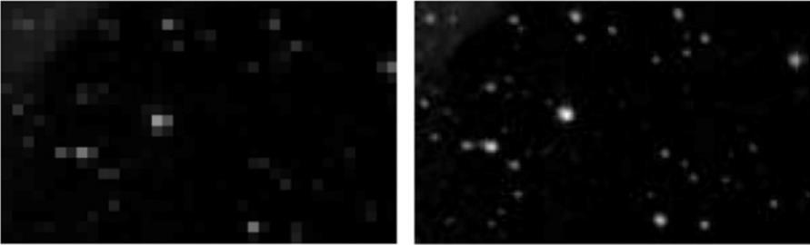
Astronomical observation
SR for improvement of quality of astrological images . Many tightly grouped stars and far away objects can be visualizes in better way. In this area many times many unidentified objects could also be visualized in better way.
Low Resolution
Super Resolution

Slide 15
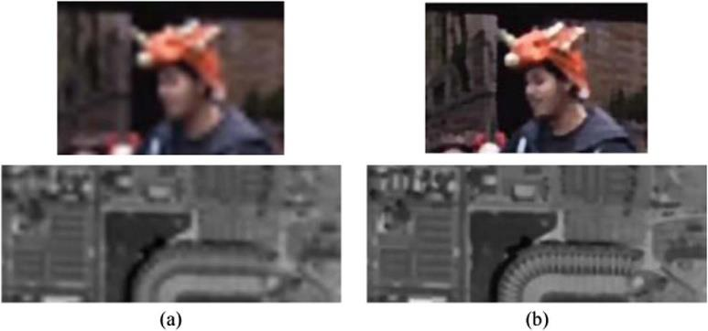
Surveillance
Digital video recorder (DVR) devices are everywhere, and they play a significant role in applications such as traffic surveillance and security monitoring.
Low Resolution
Super Resolution

Slide 16
motivation

Slide 17
motivatioN
As mentioned before, super resolution is important and have many applications.
The image resolution in displays are increasing, the older programs for enhancing the image is getting old, so it can’t keep up with the higher resolution displays.
The need of converting low resolution images to high resolution images

Slide 18
objective

Slide 19
objective
The main objective is to convert low resolution images to super resolution with more details.
To use adversarial learning to improve the current state-of-the-art in Single Image Super Resolution
Compare results of different models to decide on which models are best for each category.

Slide 20
Problem statement and solution

Slide 21
PROBLEM
SOLUTION
Low resolution image with low details and low quality.
Early algorithms based on resampling (interpolation)
Advanced algorithms based on deep learning models exploiting available examples.

Slide 22
Planning

Slide 23
planning
 | Task Name | Duration | Start | Finish | Res. Names
1 | Literature review on SR systems | 4 wks | Sun 26-09-21 | Sun 24-10-21 | All students
2 | Hands on tools including setup of the platform | 3 wks | Sun 24-10-21 | Sun 14-11-21 | all students
3 | Understanding the images resolution and super resolution | 2 wks | Sun 14-11-21 | Sun 28-11-21 | all students
4 | Detailed introduction with good survey on DL methods | 3 wks | Sun 28-11-21 | Sun 19-12-21 | all students
5 | DL approaches to solve SR problem | 3 wks | Sun 19-12-21 | Sun 09-01-22 | all students

Slide 24
planning
 | Task Name | Duration | Start | Finish | Res. Names
6 | Different architecture and up-sampling operations | 3 wks | Sun 09-1-22 | Sun 30-01-22 | all students
7 | Studying of similar application, their features, architecture | 3 wks | Sun 30-01-22 | Sun 20-02-22 | all students
8 | Full description and analysis of the application as a whole and each part of it | 3 wks | Sun 20-02-22 | Sun 13-03-22 | all students
9 | Collecting the used dataset and using required preprocessing need | 3 wks | Sun 13-03-22 | Sun 03-04-22 | Sief El-Deen
10 | Implementation of selected algorithms of the required systems on different scales. | 6 wks | Sun 13-03-22 | Sun 24-04-22 | all students

Slide 25
planning
 | Task Name | Duration | Start | Finish | Res. Names
11 | Testing the DL model, evaluating system performance | 4 wks | Sun 03-04-22 | Sun 01-05-22 | All students
12 | GUI Implementation | 4 wks | Sun 14-04-22 | Sun 08-05-22 | Amr
13 | Project documentation and presentation | 9 wks | Sun 01-05-22 | Sun 03-07-22 | all students

Slide 26
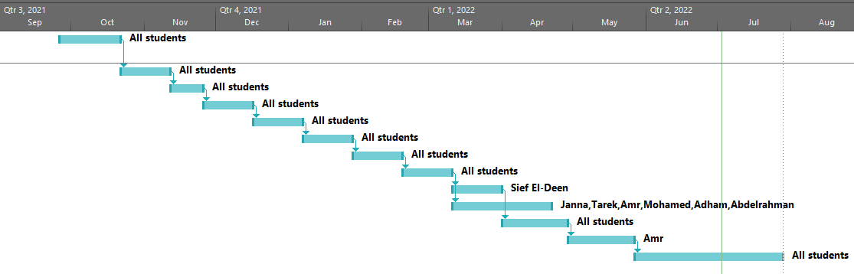
planning

Slide 27
02
Literature Review

Slide 28
Literature review
Up-sampling Methods
Network Designs
Similar Applications
Model Frameworks

Slide 29
MoDEL FRAMeworks

Slide 30
Model frameworks
Super resolution main idea is to increase the dimensions of an image, and then fill the empty spaces with meaningful pixel intensities.
Few layers are assigned for up-sampling the input image to match the dimensions of the expected output image. This can be achieved in different ways:
Pre-Up-Sampling SR
Post-Up-Sampling SR
Progressive-Up-Sampling SR
Iterative Up-and-Down Sampling SR

Slide 31
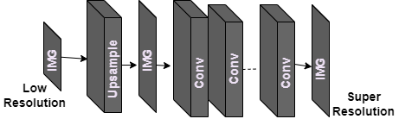
Pre-up-sampling
The LR images are up-sampled to coarse HR images with the desired size using traditional methods (e.g., bicubic interpolation), then deep CNNs are applied on these images for reconstructing high-quality details.
The most popular method, SRCNN, was also the first to use deep learning, and has achieved impressive results.

Slide 32
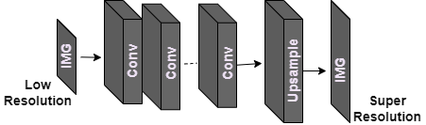
POST-up-sampling
The LR input images are fed into deep CNNs without increasing resolution, and end-to-end learnable up-sampling layers are applied at the end of the network.
Also, a learned up-sampling in the form of deconvolution/sub-pixel convolution is used, instead of using simple bicubic interpolation
Some of the models that follow this structure are FSRCNN and ESPCN

Slide 33
Model frameworks
 | Pre-Up-Sampling | Post-Up-Sampling
Framework | Pre deep CNN | Post deep CNN
Computation Complexity | High computational complexity, because large size of feature maps | Low computational complexity, because small size of feature maps
Performance | Worse and Slower | Better and Faster

Slide 34
Up-sampling Methods

Slide 35
Up-sampling methods
In addition to the up-sampling positions in the model, how to perform up-sampling is of great importance.
Interpolation Methods
Up-Sampling Methods
Learning Methods
Nearest Neighbor
Transposed Convolution
Bilinear Interpolation
Subpixel Layer
Bicubic Interpolation
Meta Upscale Module
Catmull-Rom, Cubic B-Spline, Lancoz

Slide 36
Interpolation based Methods
Nearest Neighbor
Bilinear Interpolation
Bicubic Interpolation

Slide 37
Nearest Neighbor
The nearest pixel value for each position to be interpolated, which has fast execution time but has difficulty in producing high-quality results.

Slide 38
Nearest neighbor
5.5
1
2
3
4
5
6
7
8
0
2.75
1
8
1
2
3
4
2
0
2x
3
2.25
1
.
4
.
2
4.5
5
3
For example:
5.5/8*4=2.75
4.5/8*4=2.25
6
4
4x4
Source Image
7
8
destinationValue (x_{d},y_{d})= SourceValue (x_{s,} y_{s} ) where :
SourceCoord_(x_{s}) = (destinationCoord (x_{d} ) /destinationlength)*SourceLength
SourceCoord_(y_{s}) = (destinationCoord (y_{d} ) /destinationlength)*SourceLength
8x8
Destination Image

Slide 39
Bilinear interpolation
Bilinear interpolation identifies the four nearby pixels in an image and takes the distance-weighted average of these four pixels to determine new value
𝑃′(𝑥.𝑦)=𝑃(1.1)⋅(1−𝑑)⋅(1−𝑑′)+𝑃(1.2)⋅𝑑⋅(1−𝑑′)+𝑃(2.1)⋅𝑑′⋅(1−𝑑′)+𝑃(2.2)⋅𝑑⋅𝑑′

Slide 40
Bicubic interpolation
Bicubic interpolation is an advanced image interpolation algorithm as it considers four by four adjacent pixels for a sum of 16 pixels.
High Computational Time.
Bicubic interpolation algorithm produces an eye pleasing image and it is a standard in the majority of image editing software.

Slide 41
Comparison
Comparison
Computational Time in seconds using Intel® Core i7 CPU @ 2.70 GHz and DDR3 RAM of 8 GB
Set 14 → Lina image →shape → 256X256
Interpolation Algorithms | PSNR(dB) | Computation Time | Complexity of Algorithm
Nearest neighbor | 26.05 | 0.008 | Low
Bilinear | 27.12 | 0.015 | Average
Bicubic | 27.18 | 0.028 | High

Slide 42
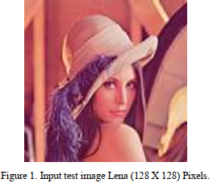
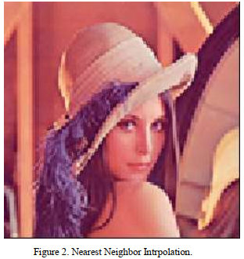

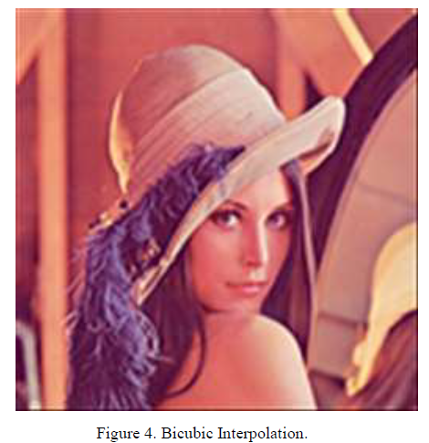
Comparison
128x128
Input image
Comparison
2x
2x
2x
256x256
Nearest Neighbour
256x256
Bilinear Interpolation
256x256
Biubic Interpolation

Slide 43
Learning based Methods
Transposed Convolution
Subpixel Layer

Slide 44
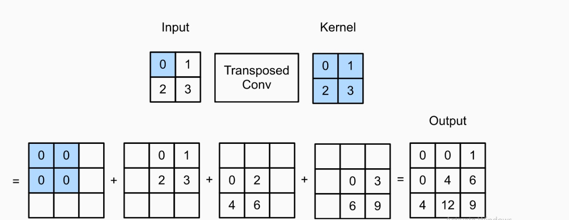
Transposed/ Deconvolution
We can use another type of CNN layers that can increase (up-sample) the spatial dimensions of intermediate feature maps.

Slide 45
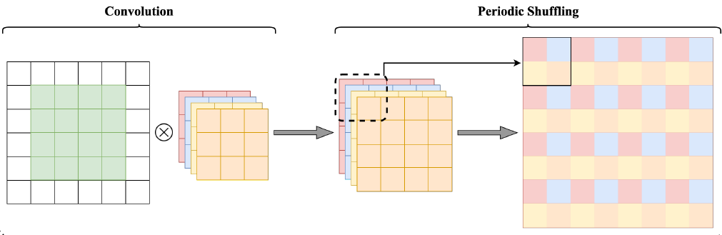
Subpixel Layer
Instead of increasing the resolution by directly increasing the number of LR feature maps, subpixel first increases the dimension of LR feature maps.
Then, The number of the LR feature maps, and then a periodic shuffling operator is used to rearrange these points in the expanded feature maps to obtain the HR output.

Slide 46
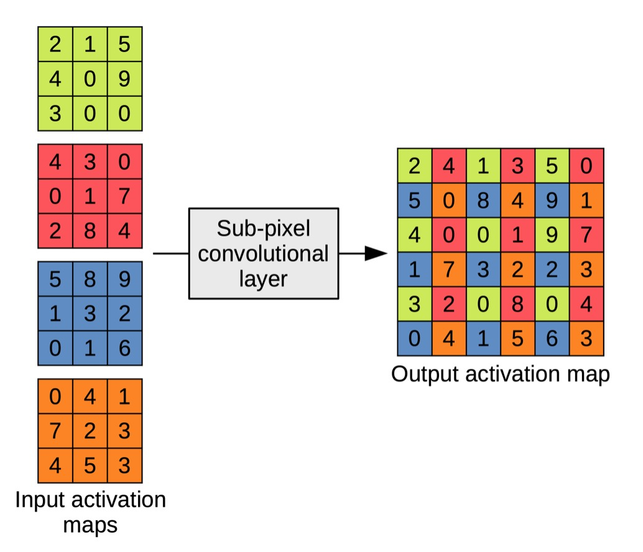
Subpixel Layer

Slide 47
Network Designs

Slide 48
Network designs
Researchers find that better reconstruction performance can be obtained by adding more convolutional layers to increase the receptive field.
However, directly stacking the layers will cause Vanishing/exploding gradients and degradation problem.
Meanwhile, adding more layers will lead to a Higher training error and more expensive computational cost.
So researchers created network designs to avoid those problems.

Slide 49
Network designs
There are several types of network designs, 3 of them are discussed in this section since they are the most common used in super resolution.
Network Designs
Residual Learning
Multipath Learning
Recursive Learning
Attention Mechanism
Dense Connection
Advanced Convolution

Slide 50
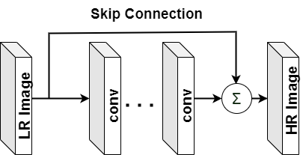
Residual Learning
To solve the gradient vanishing problem associated with ultra-deep networks, the He et al. proposed a residual learning framework.
Residual connections are simply connections between a layer and layers after the next.
A residual block is a stack of layers set in such a way that the output of a layer is taken and added to another layer deeper in the block.
This by-pass connection is known as the shortcut or the skip-connection.

Slide 51
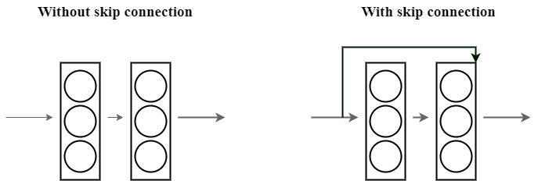
Residual Learning
On the left is stacking convolution layers together one after the other. On the right we still stack convolution layers as before but we now also add the original input to the output of the convolution block. This is called skip connection .

Slide 52
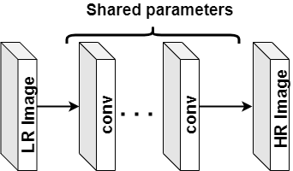
Recursive Learning
A recursive block is a collection of recursive units, where the corresponding structures among these recursive units share the same parameters.
In order to obtain a large receptive field without increasing model parameters.

Slide 53
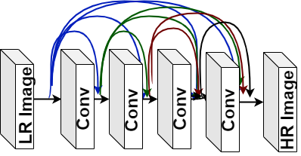
Dense Connection
Huang et al. propose DenseNet based on dense blocks
For each layer in a dense block, the feature maps of all preceding layers are used as inputs, and its own feature maps are used as inputs into all subsequent layers

Slide 54
Similar applications

Slide 55
Similar Applications
Similar real-world applications like Adobe Photoshop added super resolution feature in their application.
3 applications were used for comparative study
Adobe Photoshop
Topaz Gigapixel AI
Let’s Enhance

Slide 56
Adobe Photoshop
Adobe has been adding machine-learning and AI-powered features to Photoshop and Photoshop Lightroom. In March 2021.
It only takes the images in 2 formats (JPG, TIFF)
It has only x2 scale

Slide 57

Topaz Gigapixel AI
Topaz Gigapixel AI is an advanced image enlarging software that uses artificial intelligence to upscale photos by up to 800%
It has x2, x4, x6 and x8 scale

Slide 58
Let’s Enhance
Let's Enhance is a Ukrainian start-up which develops an online service driven by artificial intelligence.
Which allows improving images and zooming them without losing quality.
According to the developers, they used the super-resolution technology of machine learning.
It has only x2 scale

Slide 59
03
System description

Slide 60
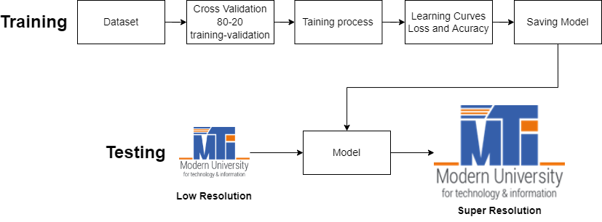
System description
This project aim to reach super resolution image, the process is to take an input low resolution image and then producing an output super resolution image that represents the high resolution image of the input.

Slide 61
04
System Implementation

Slide 62
System implementation
System Platform
System Training
Training Dataset
7 Models

Slide 63
System Platform

Slide 64




System platform
Programming Language
Libraries
Python 3.9.4
TensorFlow
Keras

Slide 65
System Training

Slide 66
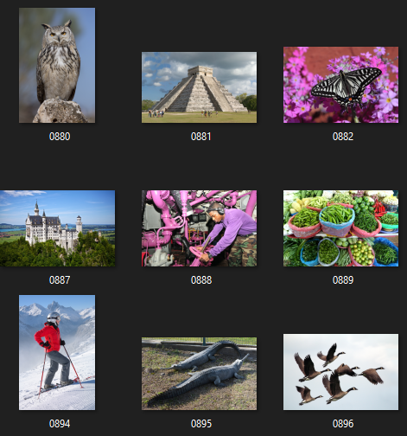
Training Dataset
We used the popular dataset DIV2K to train our models.
The DIV2K dataset contains 900 high-quality RGB images of different size for training and validation.
We divided those 900 images to 80% for training and 20% for validation.

Slide 67
Models

Slide 68
Models
Firstly, the models were trained on local personal computers, it was slow due to the computer specifications. Then the models were trained on Saturn Cloud Server having the following specifications;
→ Size: 8 cores – 64 GB RAM, 40Gi Disk Space – CPU Hardware.
7 Models
SRCNN
RDN
FSRCNN
RFDN
ESPCN
Autoencoder
ESRGAN

Slide 69
SRCNN
Super Resolution Using Deep Convolutional Neural Network

Slide 70
SRCNN Parameters
Super Resolution using Deep Convolution Neural Network (SRCNN) has been implemented using 2 different scales (2x, and 4x). As mentioned before it is trained on DIV2K dataset and 80-20 cross validation. With total number of parameters of 85,889,
Hyper parameters of SRCNN
Parameters | SRCNN
Optimizer | ADAM
Learning Rate | 3*10⁻³
Activation Function | Relu
Loss Function | MSE
Number of Epochs | 100
Batch Size | 10

Slide 71
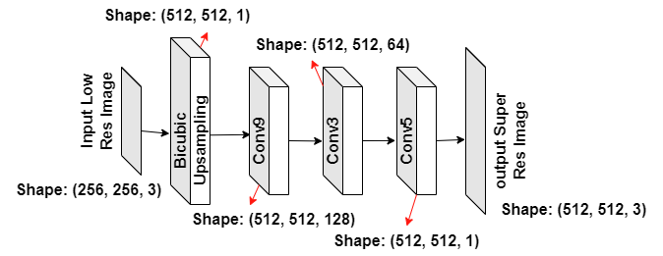
SRCNN Architecture

Slide 72
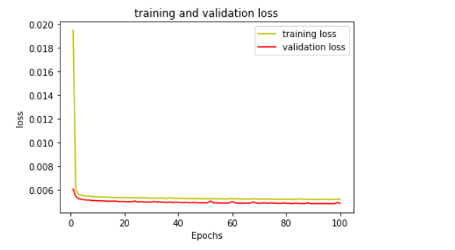
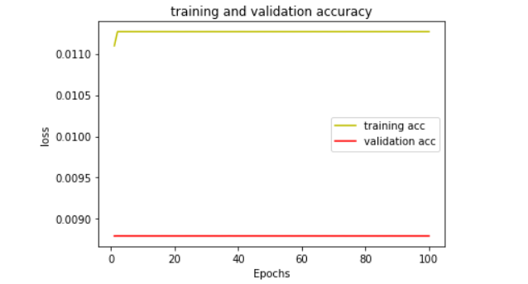
Loss
Accuracy
Learning Curves

Slide 73
FSRCNN
Fast Super Resolution Using Deep Convolutional Neural Network

Slide 74
FSRCNN Parameters
Fast Super Resolution using Deep Convolution Neural Network (FSRCNN) has been implemented using 3 different scales (2x, 4x, 8x). As mentioned before it is trained on DIV2K dataset and 80-20 cross validation. With total number of parameters for 2x scale is 13,763, and for 4x scale is 21,827
Hyper parameters of FSRCNN
Parameters | FSRCNN
Optimizer | ADAM
Learning Rate | 10⁻³
Activation Function | PRelu
Loss Function | MSE
Number of Epochs | 100
Batch Size | 10

Slide 75
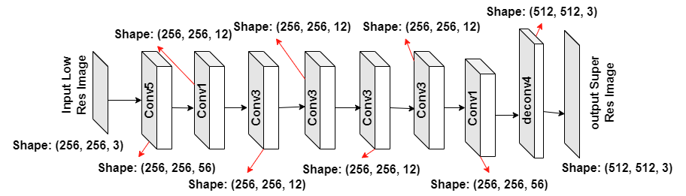
FSRCNN Architecture

Slide 76
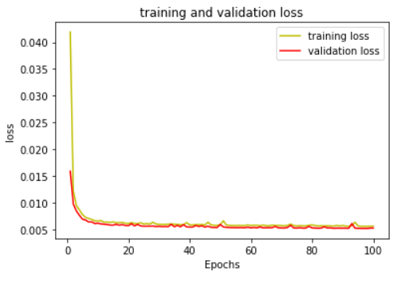
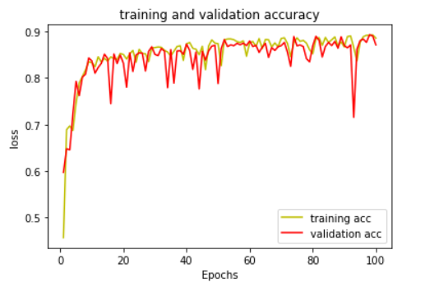
Loss
Accuracy
Learning Curves

Slide 77
ESPCN
Efficient Subpixel Convolution Network

Slide 78
ESPCN Parameters
Efficient Subpixel Convolution Network (ESPCN) has been implemented using 2 different scales (2x, 4x). As mentioned before it is trained on DIV2K dataset and 80-20 cross validation. With total number of parameters for 2x scale is 75,552, and for 4x scale is 61,680.
Hyper parameters of ESPCN
Parameters | ESPCN
Optimizer | ADAM
Learning Rate | 10⁻³
Activation Function | Relu
Loss Function | MSE
Number of Epochs | 100
Batch Size | 15

Slide 79
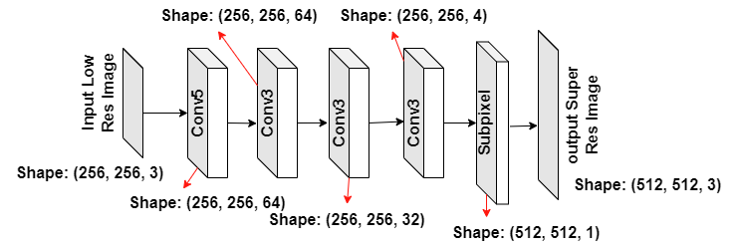
ESPCN Architecture

Slide 80
Loss
Accuracy
Learning Curves

Slide 81
RDN
Residual Dense Network

Slide 82
RDN Parameters
Residual Dense Network (RDN) has been implemented using 2 different scales (2x, 4x). As mentioned before it is trained on DIV2K dataset and 80-20 cross validation. With total number of parameters for 2x scale is 16,347,392, and for 4x scale is 16,357,796.
Hyper parameters of RDN
Parameters | RDN
Optimizer | ADAM
Learning Rate | 0.02
Activation Function | Relu
Loss Function | MSE
Number of Epochs | 70
Batch Size | 16

Slide 83
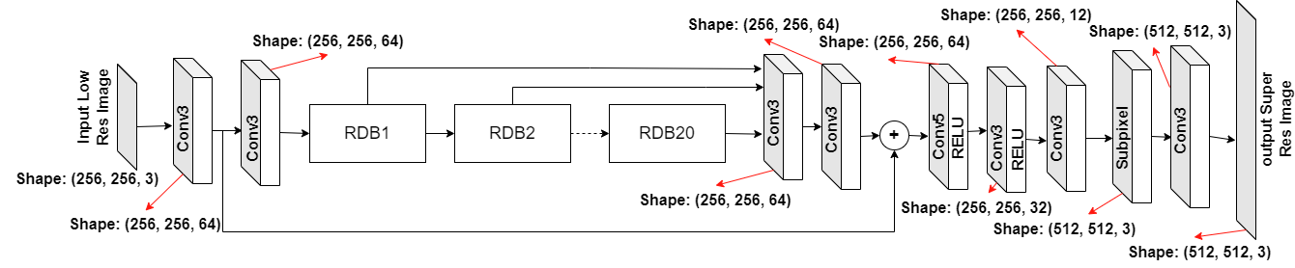
RDN Architecture

Slide 84
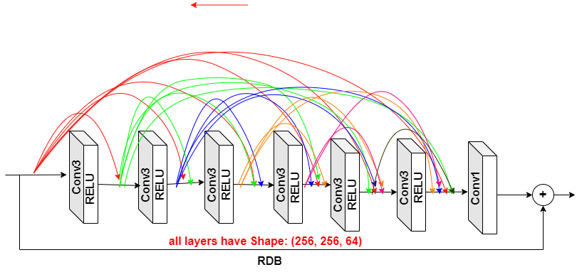
RDb Architecture

Slide 85
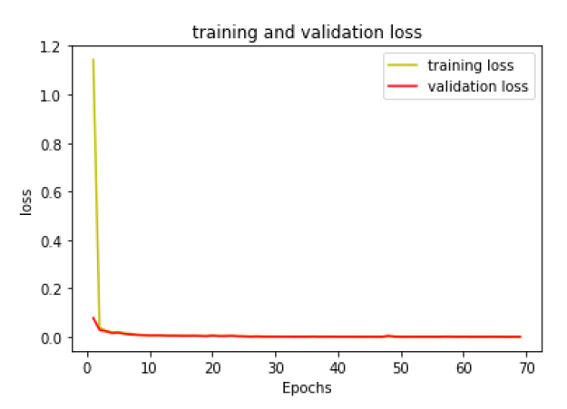
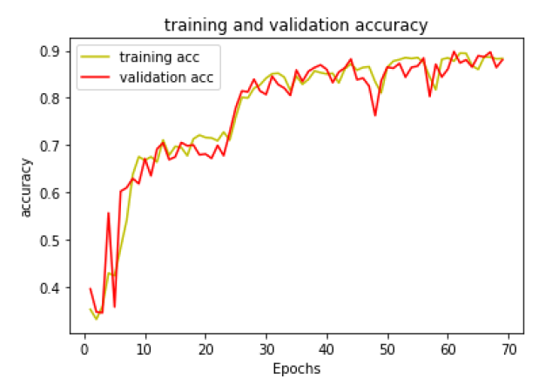
Loss
Accuracy
Learning Curves

Slide 86
RfDN
Residual Feature Distillation Network for Lightweight Image Super Resolution

Slide 87
RFDN Parameters
Residual Feature Distillation Network for Lightweight Image Super-Resolution (RFDN) has been implemented using 4 different scales (2x, 3x, 4x, 8x). As mentioned before it is trained on DIV2K dataset and 80-20 cross validation. With total number of parameters for 2x scale is 778,051, for 3x scale is 962,691, for 4x scale is 1,221,187, and for 8x scale is 2,250,365.
Hyper parameters of RFDN
Parameters | RFDN
Optimizer | ADAM
Learning Rate | 10⁻³
Activation Function | Relu
Loss Function | MSE
Number of Epochs | 100
Batch Size | 15

Slide 88
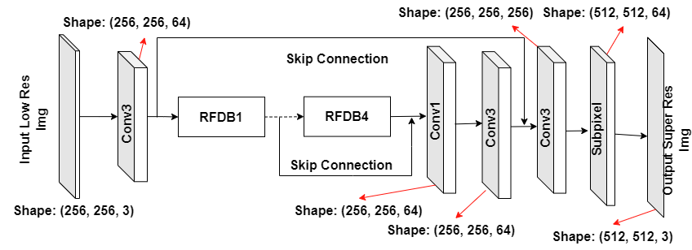
RFDN Architecture

Slide 89
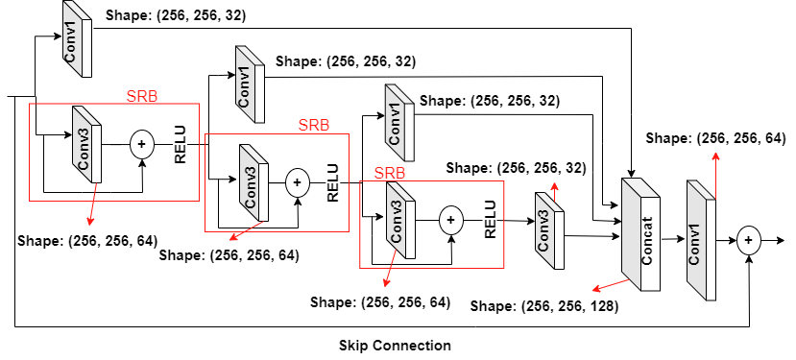
RFDb Architecture

Slide 90
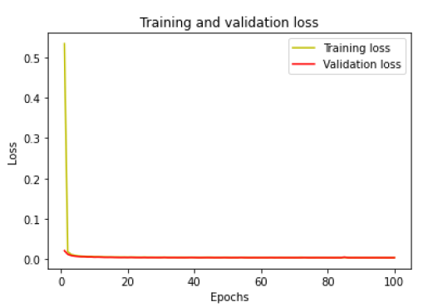
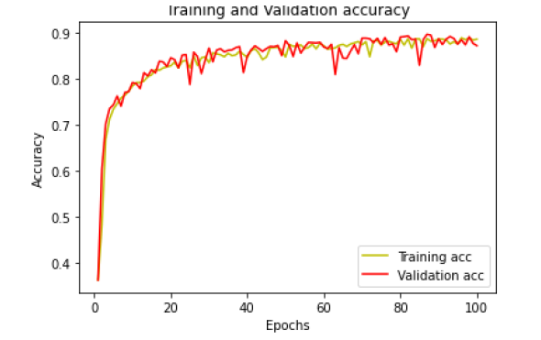
Loss
Accuracy
Learning Curves

Slide 91
Autoencoder
Autoencoder For Image Super Resolution

Slide 92
Autoencoder Parameters
Autoencoder has been implemented by two up-sampling techniques (subpixel and deconvolution), The model was trained on two different scales (2x and 4x). As mentioned, before it is trained on DIV2K dataset and 80-20 cross validation. With total number of parameters for 2x scale is 1,454,915, for 4x scale is 1,504,067 for deconvolution,
While for subpixel for 2x scale is 1,586,179,
and for 4x scale is 3,801,859,
Hyper parameters of Autoencoder
Parameters | Autoencoder
Optimizer | ADAM
Learning Rate | 10⁻³
Activation Function | Relu
Loss Function | MSE
Number of Epochs | 107
Batch Size | 10

Slide 93
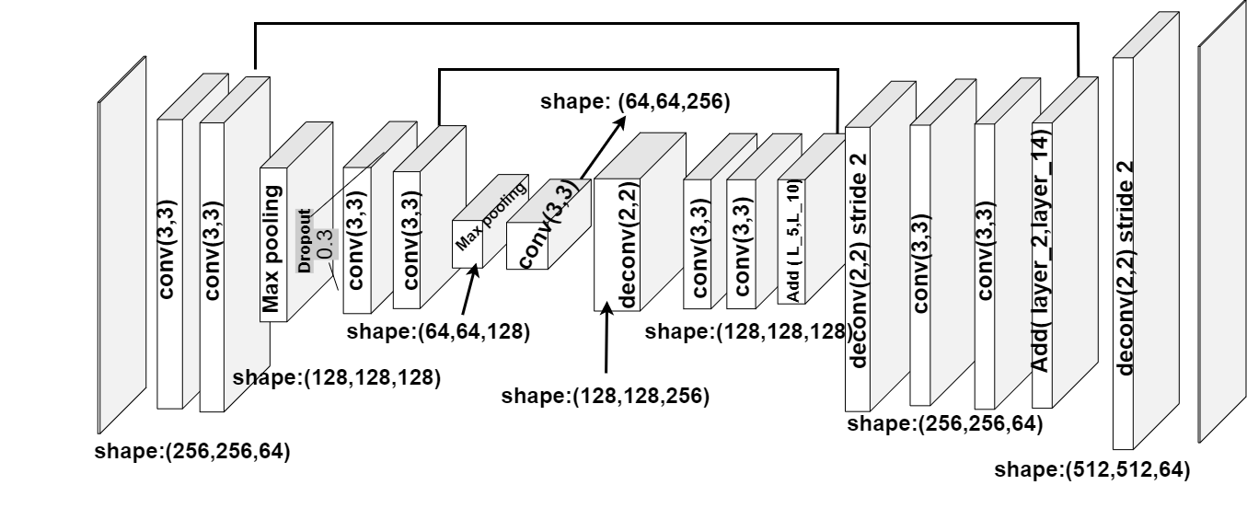
Autoencoder Architecture
Skip Connection
Super res image
Low res image
(256,256,3)
(512,512,3)
Encoder
Decoder

Slide 94
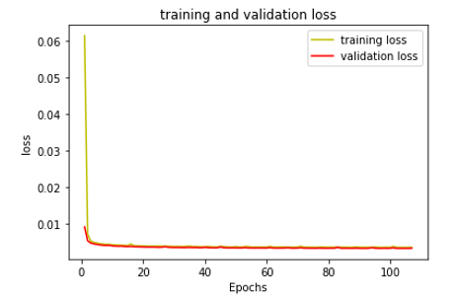
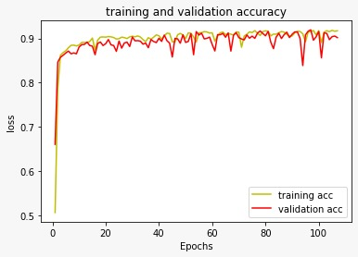
Loss
Accuracy
Learning Curves

Slide 95
ESRGAN
Enhanced Super Resolution Generative Adversarial Learning

Slide 96
Generative Adversarial Network
Gan is the state of art, is an especially effective type of generative model.
A generative adversarial network (GAN) has two parts:
The generator learns to generate plausible data. The generated instances become negative training examples for the discriminator.
The discriminator learns to distinguish the generator's fake data from real data. The discriminator penalizes the generator for producing implausible results.

Slide 97
GAN Architecture
Real Training Data
Sample
Batch
W
W
1
High Resolution
Discriminator
Low Res Image
W
W
W
w
0
Generator
Output
Super Resolution

Slide 98
ESRGAN Parameters
Enhanced Super-Resolution Generative Adversarial Networks (ESRGAN) has been implemented using scale 4x. A pretrained model and trained on DIV2K dataset. It divided into generator and discriminator with total number of parameters for generator is 16,697,987 and for discriminator is 14,505,161.
Hyper parameters of ESRGAN
Parameters | ESRGAN
Optimizer | ADAM
Learning Rate G | 5*10⁻⁵
Learning Rate D | 5*10⁻⁵
Activation Function | Relu
Loss Function | MSE
Number of Epochs | 2000
Batch Size | 15

Slide 99
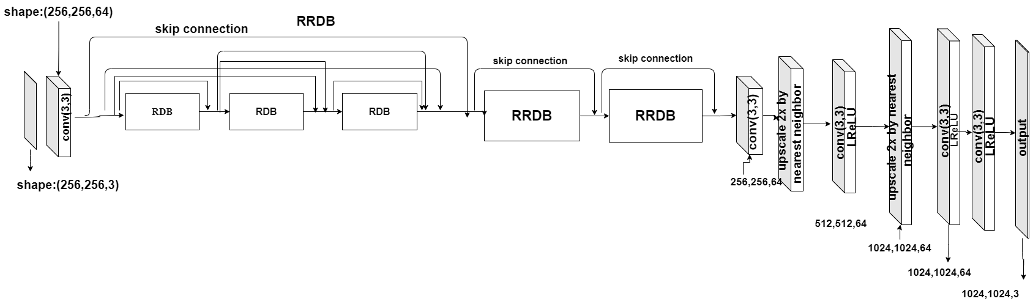
Generator Architecture

Slide 100
RDb Architecture

Slide 101
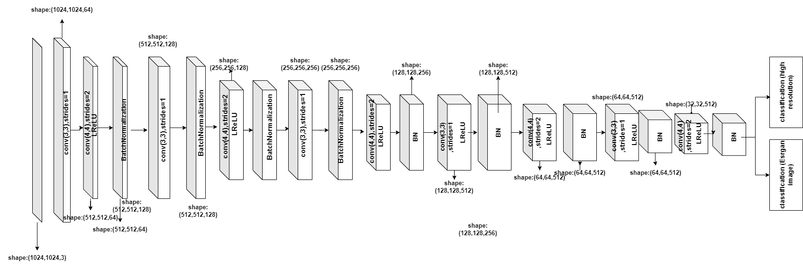
Discriminator Architecture

Slide 102
05
System Testing

Slide 103
System Testing
Methods of Assessment
Testing Datasets
Results

Slide 104
Methods of assessment

Slide 105
Image Quality assessment
Subjective methods
Objective methods

Slide 106
Subjective methods
In subjective testing a group of people are asked to give their opinion about the quality of each image.
Types:
Single stimulus categorical rating
Double stimulus categorical rating
Mean opinion score (MOS)
Ordering by force-choice pair-wise comparison
Pair-wise similarity judgments
Z-score

Slide 107
Mean Opinion Score
MOS is a manual way to determine the results of a model, where humans are asked to rate an image between 1 and 5. The results are aggregated, and the average result is used as a metric.
1 2 3 4 5

Slide 108
Objective methods
Objective methods commonly use a specific formulation to compute the results, which are simple and fair, thus become the mainstream assessment method in SISR.
However, they can only reflect the recovery of image pixels from a numerical point of view and are difficult to accurately measure the true visual effect of the image.
MSE
PSNR
SSIM

Slide 109
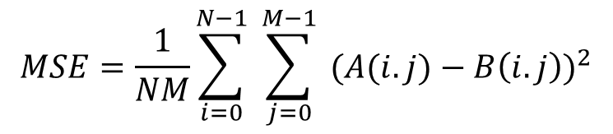
Mean Square Error
The difference between the Pixel value of one image and the corresponding Pixel value of the other image.
The MSE measures the average of the square of the errors
$$MSE=\frac{1}{NM}\sum_{i=0}^{N−1}{ }\sum_{j=0}^{M−1}{ }(A(i.j)−{B\left(i.j\right))}^{2}$$

Slide 110
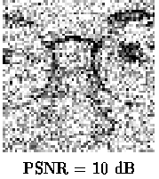
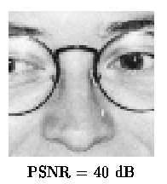
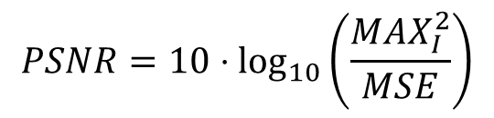
Peak Signal to Noise Ratio
PSNR is used to calculate the ratio between the maximum possible signal power and the power of the distorting noise.
$$PSNR=10⋅\log_{10}\left(\frac{MAX_{I}^{2}}{MSE}\right)$$

Slide 111
Structure Similarity Index Method
It measures the similarity between two images.
SSIM can be expressed through these three terms as:
L is the luminance (used to compare the brightness between two images)
C is the contrast (used to differ the ranges between the brightest and darkest region of two images)
S is the structure (used to compare the local luminance pattern between two images to find the similarity of the images) and α, β and γ are the positive constants.
$$SSIM{(}x.y)=[l\left(x.y\right)]^{α}⋅[c(x.y)]^{β} ⋅[s(x.y)]^{γ}$$

Slide 112
Testing Datasets

Slide 113
Testing Datasets
The testing LR images were generated by down-sampling HR images with scaling factors (x2, x4) using bicubic interpolation
4 datasets for testing:
Set5 Dataset
Set14 Dataset
Medical Dataset
Project’s Dataset

Slide 114
Testing Datasets
Two widely used benchmark datasets: Set5, Set14.
A created dataset which consists of nature, and detailed images.
A created medical dataset.
We computed peak signal-to-noise ratio(PSNR) and structural similarity (SSIM) to measure the quality of super resolution images.
Datasets | Set5 | Set14 | Medical | Project
No. of Images | 5 | 14 | 5 | 8
Size of images | From (256,256) To (512,512) | From (276, 276) To (656,720) | From (796, 824) To (1312, 1080) | From (1920, 1080) To (4624, 3468)

Slide 115
Results

Slide 116
Results
The performance can be assessed in 3 factors
Objectively
Subjectively
Time of Processing

Slide 117
Objectively

Slide 118
Set5 Dataset
Models |  | Scales
 |  | X2 | X4 | X2X2
Implemented models | SRCNN | 32.63916/0.90650 | 31.1635/0.6996 | 31.661/0.780
 | FSRCNN | 32.58261/ 0.8710 | 31.3444/0.7421 | 30.318/0.714
 | RDN | 33.7007/ 0.8983 | 30.5153/0.7212 | 31.515/0.783
 | ESPCN | 31.66237/ 0.8891 | 31.3510/0.7090 | 30.366/0.780
 | RFDN | 34.13620/ 0.9069 | 31.3595/0.7626 | 31.857/0.793
 | Autoencoder (Deconvolution) | 34.45608/ 0.9142 | 31.4657/0.7842 | 32.190/0.820
 | Autoencoder (Subpixel) | 33.30608/ 0.8870 | 31.7322/0.7734 | 30.941/0.744
 | ESRGAN | - | 32.0604/0.8103 | -
Similar Systems | Adobe | 32.63916/ 0.85887 | - | -
 | Topaz | 32.39536/ 0.85871 | 30.6606/0.6889 | 30.249/0.622
 | Let's enhance | 31.43409/0.80774 | - | -

Slide 119
Set5 Dataset

Slide 120
Why don’t we use scale x2 twice instead of x4 ? Scale 4 takes more training time, while double scale 2 takes more testing time

Slide 121
Set14 Dataset
Models |  | Scales
 |  | X2 | X4
Implemented models | SRCNN | 32.43738/0.80284 | 30.8697/0.58027
 | FSRCNN | 31.53111/0.78463 | 30.7079/0.61426
 | RDN | 32.32212/0.83647 | 30.04425/0.60644
 | ESPCN | 30.96817/0.80313 | 30.95899/0.5885
 | RFDN | 32.78939/0.85742 | 30.65615179/0.64027
 | Autoencoder (Deconvolution) | 32.01110/0.78212 | 30.80071/0.64341
 | Autoencoder (Subpixel) | 32.09487/0.78657 | 30.95064/0.63760
 | ESRGAN | - | 30.9526/0.63648
Similar Systems | Adobe | 31.93029/0.81220 | -
 | Topaz | 31.73144/0.79075 | 30.41046/0.5943
 | Let's enhance | 30.98211/0.75176 | -

Slide 122
Set14 Dataset

Slide 123
Medical Dataset
Models |  | Scales
 |  | X2 | X4
Implemented models | SRCNN | 42.7448/0.9797 | 35.7031/0.80991
 | FSRCNN | 38.2166/0.9695 | 36.8302/0.90391
 | RDN | 43.6734/0.9849 | 37.0073/0.91915
 | ESPCN | 38.8061/0.9867 | 35.9979/0.80065
 | RFDN | 43.9371/0.9846 | 36.6184/0.89959
 | Autoencoder (Deconvolution) | 43.0859/0.9866 | 36.0785/0.91405
 | Autoencoder (Subpixel) | 41.0616/0.9689 | 37.2252/0.91079
 | ESRGAN | - | 35.1667/0.84963
Similar Systems | Adobe | 41.0863/0.9634 | -
 | Topaz | 35.7185/0.8924 | 33.99009/ 0.83946
 | Let's enhance | 32.8545/0.7240 | -

Slide 124
Medical Dataset

Slide 125
project Dataset
Models |  | Scales
 |  | X2 | X4
Implemented models | SRCNN | 35.84501/0.88099 | 33.47987/0.77020
 | FSRCNN | 34.28589/0.86739 | 33.26920/0.75841
 | RDN | 35.30866/0.88066 | 32.37607/0.74327
 | ESPCN | 34.04948/0.88422 | 33.25715/ 0.765083
 | RFDN | 35.43145/0.88052 | 32.44613/0.718838
 | Autoencoder (Deconvolution) | 35.3721/0.86799 | 32.5335/0.7643
 | Autoencoder (Subpixel) | 35.54974/0.87153 | 33.3456/0.76206
 | ESRGAN | - | 32.3277/0.68941
Similar Systems | Adobe | 35.26006/0.879351 | -
 | Topaz | 33.70534/0.82786 | 32.31021/0.70849

Slide 126
Medical Dataset

Slide 127
Subjectively

Slide 128
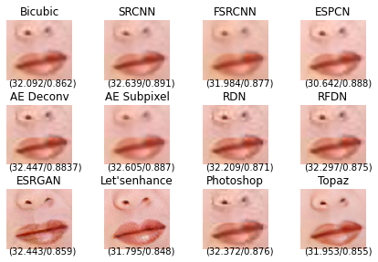

Set5 Dataset
Woman Image
2x
(172, 114)
Low resolution

Slide 129
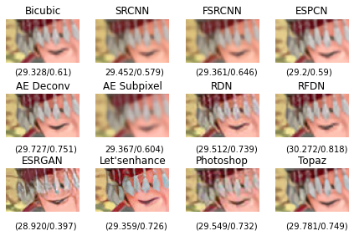

Set14 Dataset
Comic Image
2x
(131, 125)
Low resolution

Slide 130
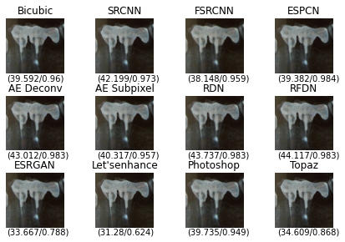

Medical dataset
Fifth Image
2x
(576, 432)
Low resolution

Slide 131


project dataset
Nature2 Image
2x
(960, 540)
Low resolution

Slide 132
Time of processing

Slide 133
Set5 Dataset
Models | Baby (512, 512) |  | Bird (288, 288 ) |  | Woman (228, 344)
 | X2 | X4 | X2 | X4 | X2 | X4
SRCNN | 0.96s | 3.13s | 0.31s | 1.04s | 0.29s | 1.00s
FSRCNN | 0.31s | 0.34s | 0.19s | 0.12s | 0.08s | 0.12s
RDN | 82.01s | 32.02s | 22.84s | 22.98s | 22.02s | 9.39s
ESPCN | 0.20s | 0.22s | 0.08s | 0.09s | 0.09s | 0.08s
RFDN | 1.76s | 2.91s | 0.54s | 1.09s | 0.49s | 1.24s
Autoencoder (Deconvolution) | 0.97s | 1.79s | 0.57s | 0.80s | 0.32s | 0.54s
Autoencoder (Subpixel) | 1.19s | 2.63s | 0.58s | 1.03s | 0.38s | 0.80s
ESRGAN | - | 38.86s | - | 13.72s | - | 13.58s

Slide 134
Set14 Dataset
Models | Baboon (500, 480) |  | Face (276, 276 ) |  | Lenna (512, 512)
 | X2 | X4 | X2 | X4 | X2 | X4
SRCNN | 0.74s | 2.94s | 0.27s | 0.96s | 0.83s | 3.10s
FSRCNN | 0.20s | 0.32s | 0.07s | 0.10s | 0.22s | 0.36s
RDN | 84.29s | 30.57s | 21.28s | 20.62s | 67.68s | 33.14s
ESPCN | 0.20s | 0.20s | 0.08s | 0.09s | 0.19s | 0.23s
RFDN | 1.56s | 2.65s | 1.15s | 3.24s | 1.79s | 3.11s
Autoencoder (Deconvolution) | 0.87s | 1.59s | 0.32s | 0.53s | 0.96s | 1.78s
Autoencoder (Subpixel) | 1.06s | 2.41s | 0.53s | 0.79s | 1.17s | 2.61s
ESRGAN | - | 34.57s | - | 13.29s | - | 41.46s

Slide 135
Medical dataset
Models | First (1080, 1312) |  | Second (824, 796) |  | Third (960, 1280)
 | X2 | X4 | X2 | X4 | X2 | X4
SRCNN | 4.38 | 17.54 | 1.98 | 7.83 | 3.63 | 14.56
FSRCNN | 1.17 | 1.85 | 0.49 | 0.84 | 1.01 | 1.62
RDN | 325.81 | 243.18 | 202.07 | 142.08 | 298.71 | 150.96
ESPCN | 0.82 | 1.07 | 0.39 | 0.52 | 0.72 | 0.95
RFDN | 9.30 | 15.69 | 4.33 | 7.23 | 8.07 | 13.71
Autoencoder (Deconvolution) | 5.46 | 9.58 | 2.37 | 4.39 | 4.32 | 8.14
Autoencoder (Subpixel) | 6.44 | 14.33 | 2.95 | 6.64 | 5.46 | 12.25
ESRGAN | - | 212.54 | - | 98.13 | - | 184.29

Slide 136
project dataset
Models | Details (816, 612) |  | MTI (867, 1156 ) |  | Toys (879, 732)
 | X2 | X4 | X2 | X4 | X2 | X4
SRCNN | 1.55 | 6.15 | 3.01 | 11.94 | 1.91 | 7.89
FSRCNN | 0.38 | 0.64 | 0.84 | 1.27 | 0.48 | 0.81
RDN | 116.27 | 142.18 | 232.88 | 123.47 | 148.93 | 144.72
ESPCN | 0.31 | 0.41 | 0.77 | 0.82 | 0.44 | 0.56
RFDN | 3.97 | 10.34 | 7.23 | 21.00 | 4.63 | 21.05
Autoencoder (Deconvolution) | 1.82 | 3.34 | 3.66 | 6.76 | 2.36 | 4.35
Autoencoder (Subpixel) | 2.22 | 5.04 | 4.47 | 8.32 | 2.88 | 6.56
ESRGAN | - | 77.53 | - | 152.27 | - | 116.50

Slide 137
06
GUI DEMO

Slide 138

GUI Demo

Slide 139
07
Conclusion

Slide 140
Conclusion
We have given a comprehensive overview of DL-based single image super resolution models,
SRCNN
FSRCNN
ESPCN
RDN
RFDN
Autoencoder
ESRGAN
according to their architecture and results.

Slide 141
Conclusion
A detailed introduction to the related works of SISR, and compared the results of the implemented models with the similar applications. In order to view the performance of each model more intuitively
A detailed comparison of reconstruction results.
According to the 3 factors mentioned, from the results we can assume that:
1. Objectively: The most consistent model over all the tested datasets is the RFDN, and Autoencoder Deconvolution.
2. Subjectively: The most consistent model over all the tested datasets is the RFDN, and Let’s Enhance.
3. Time of Processing: The fastest models are ESPCN, and FSRCNN.

Slide 142
08
Future Work

Slide 143
Future work
Improving results of the models by training the models on more time and larger datasets.
Build a Web app with stable server that can handle the models and predict fast super resolution images.
Build a Mobile app (IOS, and Android) that can predict fast super resolution images.
Modification of the architecture used in building the model so that we can achieve higher accuracy and less information loss.
Working on video Super Resolution.

Slide 144
Thanks

